Slide 1
Module 4
10.1 INTRODUCTION
10.2 BLOCK CODING
10.3 CYCLIC CODES
10.4 CHECKSUM
10.5 FORWARD ERROR CORRECTION
Notes:
10.#

Slide 2
    10-1 INTRODUCTION
TCP/IP protocol does not define any protocol in DLL or PL.
These two layers are territories of networks that when connected make up the Internet.
These networks (wired/wireless), provide services to upper three layers of TCP/IP suite.
Networks must be able to transfer data from one device to another with acceptable accuracy.
For most of the applications, system must guarantee that data received are identical to the one transmitted .
Notes:
10.#

Slide 3
    INTRODUCTION
In transmission, there are possibilities that any time message gets corrupted.
Many factors alter one or more bits of a message.
Some applications require a mechanism for detecting and correcting errors.
Some applications can tolerate some errors.
Eg: A/V (random errors )
but transfer of text, expect high level of accuracy.
Discuss some issues related, directly or indirectly, to error detection and correction.
Notes:
10.#

Slide 4
Types of Errors
Whenever bits flow from one point to another, they are subject to unpredictable changes because of interference.
This interference can change the shape of the signal.
The term single-bit error means that only 1 bit of a given data unit (such as a byte, character, or packet) is changed from 1 to 0 or from 0 to 1.
The term burst error means that 2 or more bits in the data unit have changed from 1 to 0 or from 0 to 1. Figure below shows the effect of a single-bit and a burst error on a data unit.
Notes:
10.#

Slide 5
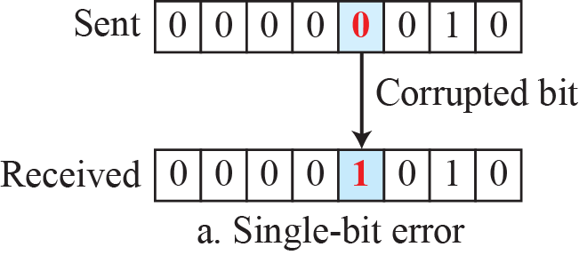
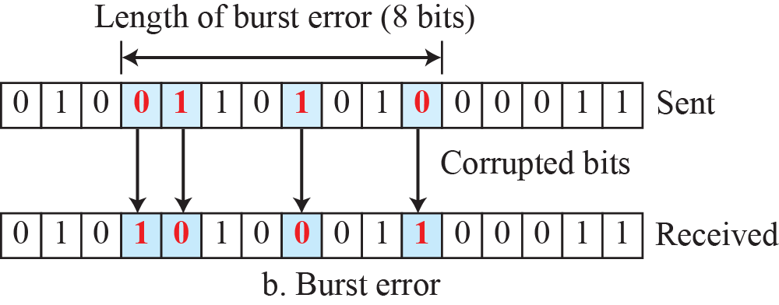
Single-bit and burst error
Notes:
10.#

Slide 6
Types of Errors
Burst error is more likely to occur than single bit error.
Reason is duration of noise signal is longer than the duration
of a bit.
When noise affects data, it affects set of bits.
Number of bits affected depends on the duration of the noise and data rate.
Eg: If we send 1 kbps of data, a noise 1/100 s can affect 10 bits.
If 1 Mbps data rate, noise can affect 10,000 bits.
Notes:
10.#

Slide 7
Redundancy
The central concept in detecting or correcting errors is redundancy.
To be able to detect or correct errors, need to send some extra bits with our data.
These redundant bits are added by the sender and removed by the receiver.
Presence of redundant bits allows the receiver to detect or correct corrupted bits.
Notes:
10.#

Slide 8
Detection versus Correction
The correction of errors is more difficult than the detection.
In error detection, check if any error has occurred. The answer is a simple yes or no.Not interested in the number of corrupted bits.
A single-bit error is the same for us as a burst error.
In error correction,
Need to know the exact number of bits that are corrupted and, more importantly, their location in the message.
Notes:
10.#

Slide 9
Coding
Redundancy is achieved through various coding schemes.
The sender adds redundant bits through a process that creates a relationship between the redundant bits and the actual data bits.
The receiver checks the relationships between the two sets of bits to detect errors.
The ratio of redundant bits to data bits and the robustness of the process are important factors in any coding scheme.
Notes:
10.#

Slide 10
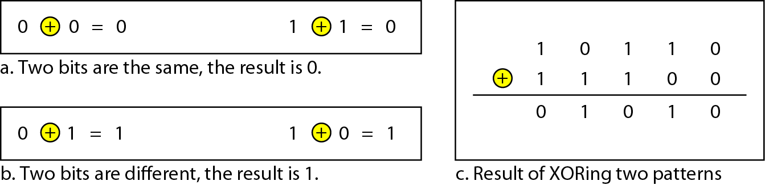
Coding
Two coding schemes are
i) Block coding ii) Convolution coding
Concentrate on block codes.
In modulo-N arithmetic, the integers in the range 0 to N −1inclusive is used,

Slide 11
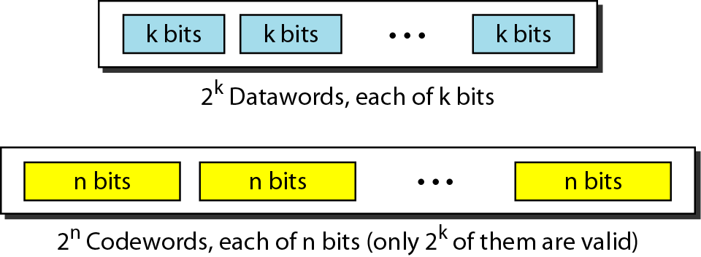
    10-2 BLOCK CODING
In block coding, message is divided into blocks, each of k bits, called data words.
Add r redundant bits to each block to make the length n = k + r.
The resulting n-bit blocks are called code words.
Notes:
10.#

Slide 12
    BLOCK CODING
In block coding, we have set of data words, each of size k, code words, each of size n.
Since n>k, the possible number of code words are larger than the data words.
Block coding process is one-to-one, same data word is encoded as code word.
2^{n} - 2^{K} code words are not used.
If receiver receives invalid codeword, it indicates data is corrupted during transmission.
Notes:
10.#

Slide 13
Error Detection
How can errors be detected by using block coding?
If the following two conditions are met, the receiver can detect a change in the original codeword.
a. The receiver has (or can find) a list of valid
code words.
b. The original codeword has changed to an invalid
one.
Notes:
10.#

Slide 14
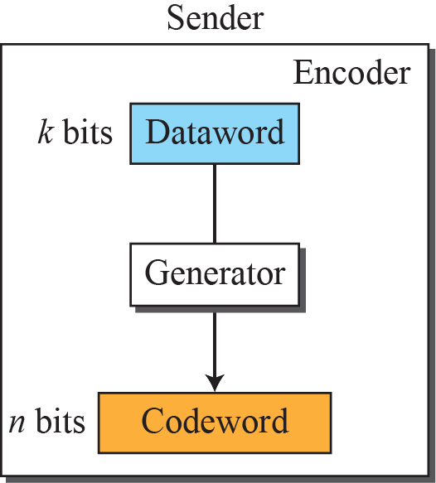
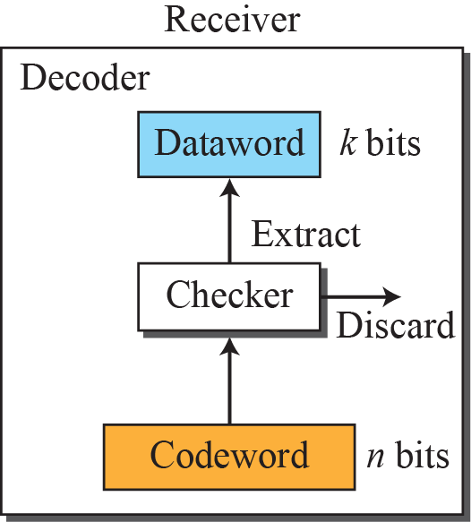

Process of error detection in block coding
10.<number>
Notes:
10.#

Slide 15
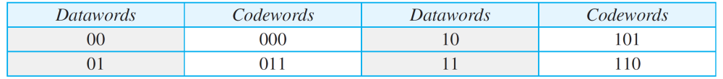
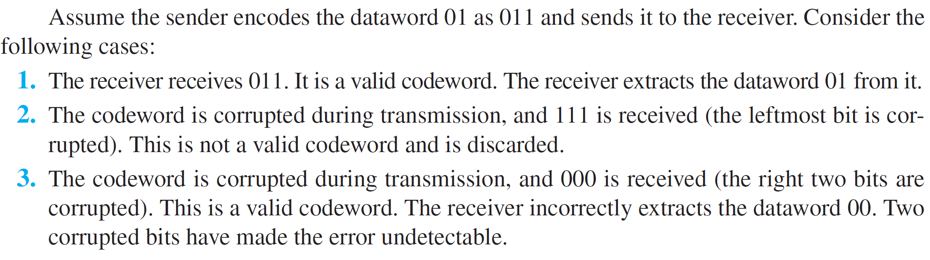
Example 10.1
Let us assume that k = 2 and n = 3. Table below shows the list of data words and code words.
A code for error detection

Slide 16
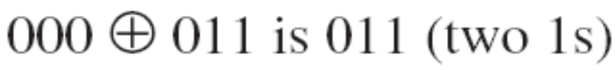
Hamming distance
The Hamming distance between two words(of same size) is the number of differences between corresponding bits. (total number of 1’s).
Why HD in Error detection????
HD between the sent code word & received codeword is the number of bits that got corrupted during transmission.
Eg: Let us find the Hamming distance between two pairs of words.

Slide 17
Hamming Distance
The Hamming distance d(000, 011) is 2.
The Hamming distance d(10101, 11110) is 3 because
If the HD between sent & received code word is not zero, then code word has been corrupted during transmission.
The minimum Hamming distance is the smallest Hamming distance between all possible pairs in a set of words.

Slide 18
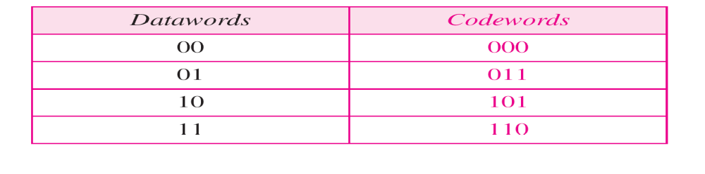
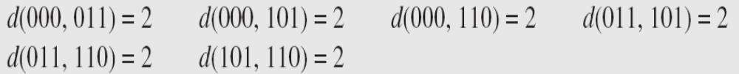
Hamming distance
Find the minimum Hamming distance of the coding scheme in
We first find all Hamming distances
The d_{min} in this case is 2

Slide 19
Example 10.2
Let us find the Hamming distance between two pairs of words.

Slide 20
Example 10.3
The minimum Hamming distance for our first code scheme (Table 10.1) is 2.
This code guarantees detection of only a single error. For example, if the third code word (101) is sent and one error occurs, the received code word does not match any valid code word.
If two errors occur, however, the received code word may match a valid code word and the errors are not detected.

Slide 21
Example 10.6
In our first code (Table 10.1), the numbers of 1s in the nonzero codewords are 2, 2, and 2. So the minimum Hamming distance is dmin = 2.

Slide 22
LINEAR BLOCK CODES
Almost all block codes used today belong to a subset called linear block codes.
A linear block code is a code in which the exclusive OR (addition modulo-2) of two valid code words creates another valid codeword.

Slide 23
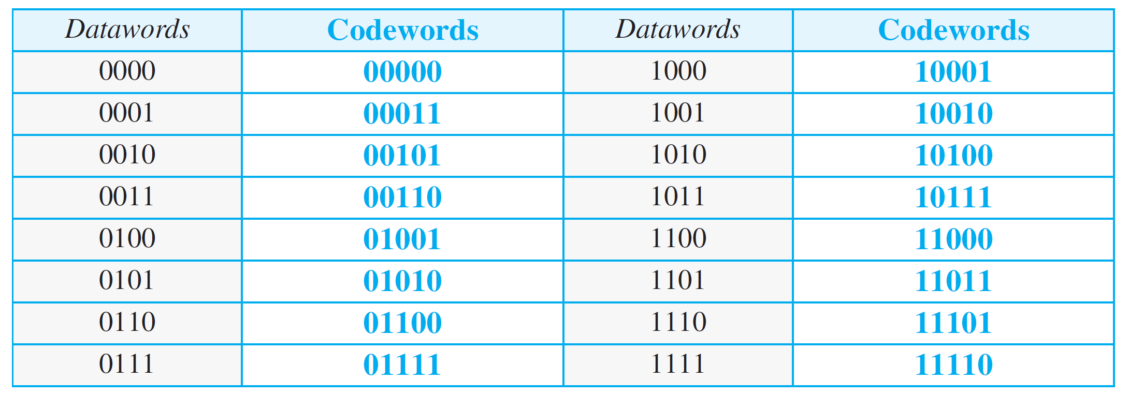
Table : Simple parity-check code C(5, 4)

Slide 24
Example
Let us see if the two codes defined in Tables above, belong to the class of linear block codes.
1. The scheme in the above Table is a linear block code
because the result of XORing any codeword with any
other codeword is a valid codeword.
So the minimum Hamming distance is d_{min} = 2.
2. The scheme in Table second is also a linear block code.
We can create all four codewords by XORing two
other codewords.
So the minimum hamming distance is d_{min} = 3.

Slide 25
Simple Parity check code
A simple parity-check code is a single-bit error-detecting code in which n = k + 1 with d_{min} = 2.
The extra bit, called parity bit , is selected to make number of 1’s in the code word even.
The code is single-bit error detecting code.
It can not correct any error.
In the fig. encoder takes a copy of 4 bit data word(a_{0,}a_{1,}a_{2,}a₃ ) and generates a parity bit r_{0.}
Parity bit creates the 5-bit code word.

Slide 26
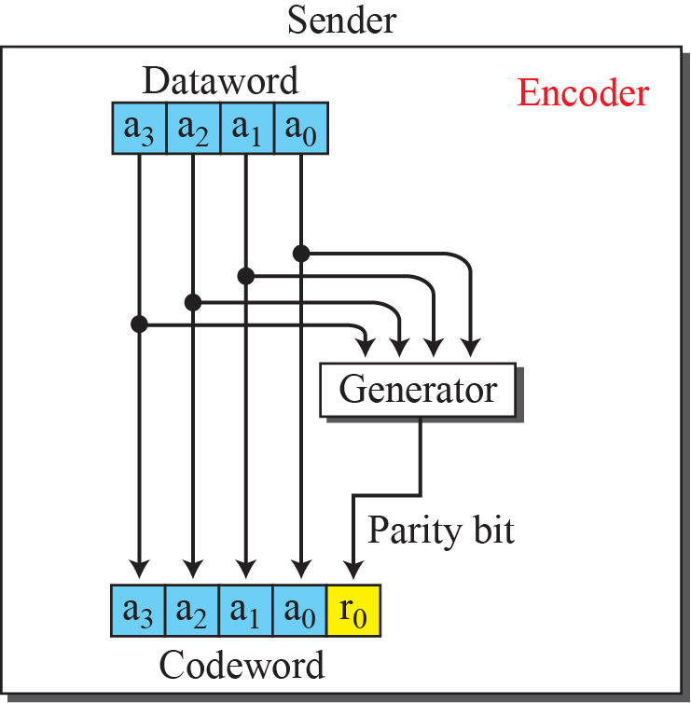
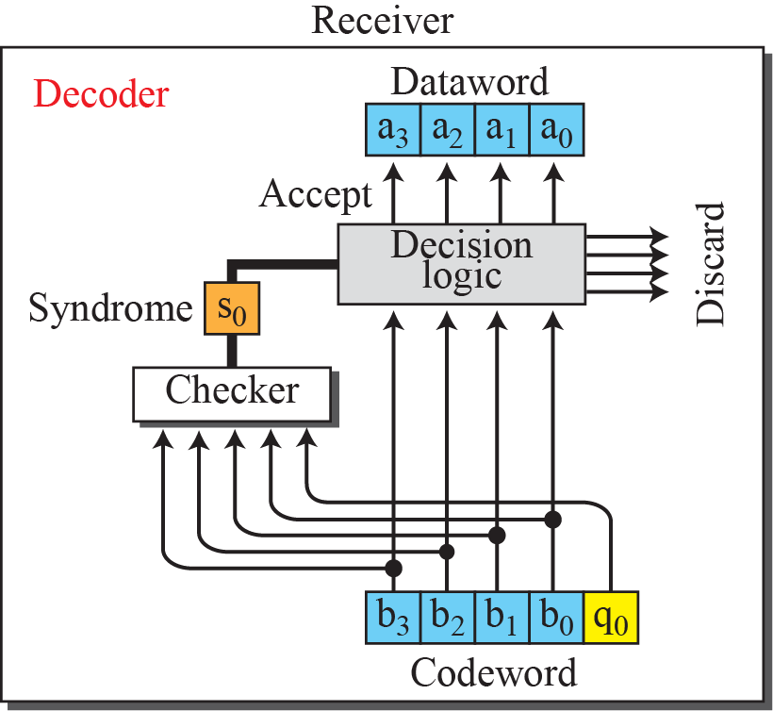
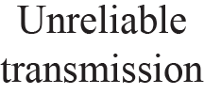
Encoder and decoder for simple parity-check code
Notes:
10.#

Slide 27
Simple Parity check code
The parity bit that is added makes the number of 1’s in the codeword even. i.e
r₀ = a₀ +a₁ +a₂ +a₃ (modulo-2)
If number of 1s is even, the result is 0.
If number of 1s is odd, the result is 1.
The sender sends the code word which is corrupted during transmission.
The receiver receives 5 bit code word.
The checker performs modulo-2 of all the bits received. The result is called syndrome.
s₀ = b₀ +b₁ +b₂ +b₃ + q₀ (modulo-2)

Slide 28
Continued..
If number of 1s in the codeword is even, the syndrome is 0.
If number of 1s in the codeword is odd, the syndrome is 1.
The syndrome is passed to decision logic analyzer. If Syndrome is 0, no error in the code word received, data portion is extracted.
If syndrome is 1, error in the received codeword and discarded.

Slide 29
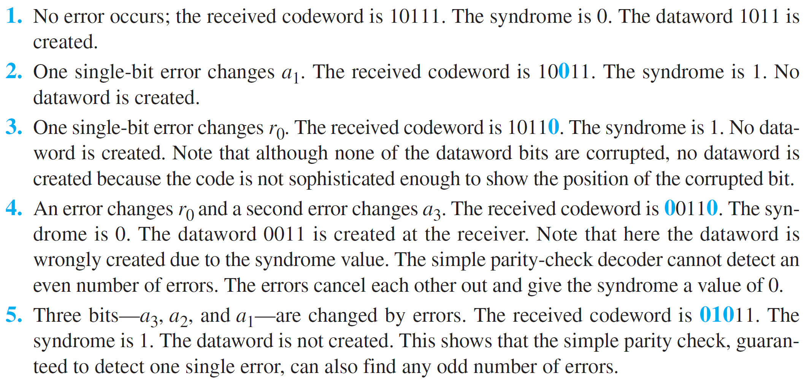
Example 10.7
Let us look at some transmission scenarios. Assume the sender sends the data word 1011. The codeword created from this data word is 10111, which is sent to the receiver. Five cases can be examined:

Slide 30
    10-3 CYCLIC CODES
Cyclic codes are special linear block codes with one extra property.
In a cyclic code, if a codeword is cyclically shifted (rotated), the result is another codeword.
Eg:1011000 is a codeword and if it is cyclically left-shifted, then 0110001 is also a codeword.
We can shift the bits using
b₁=a_{0,}b₂=a_{1,} b₃=a_{2,} b₄=a_{3,} b₅=a_{4,} b₆=a_{5,} b₀=a₆
Notes:
10.#

Slide 31
Cyclic Redundancy Check
Cyclic codes are created to correct errors.
Discuss a subset of cyclic codes called the cyclic redundancy check (CRC), which is used in networks such as LANs and WANs.
Notes:
10.#

Slide 32
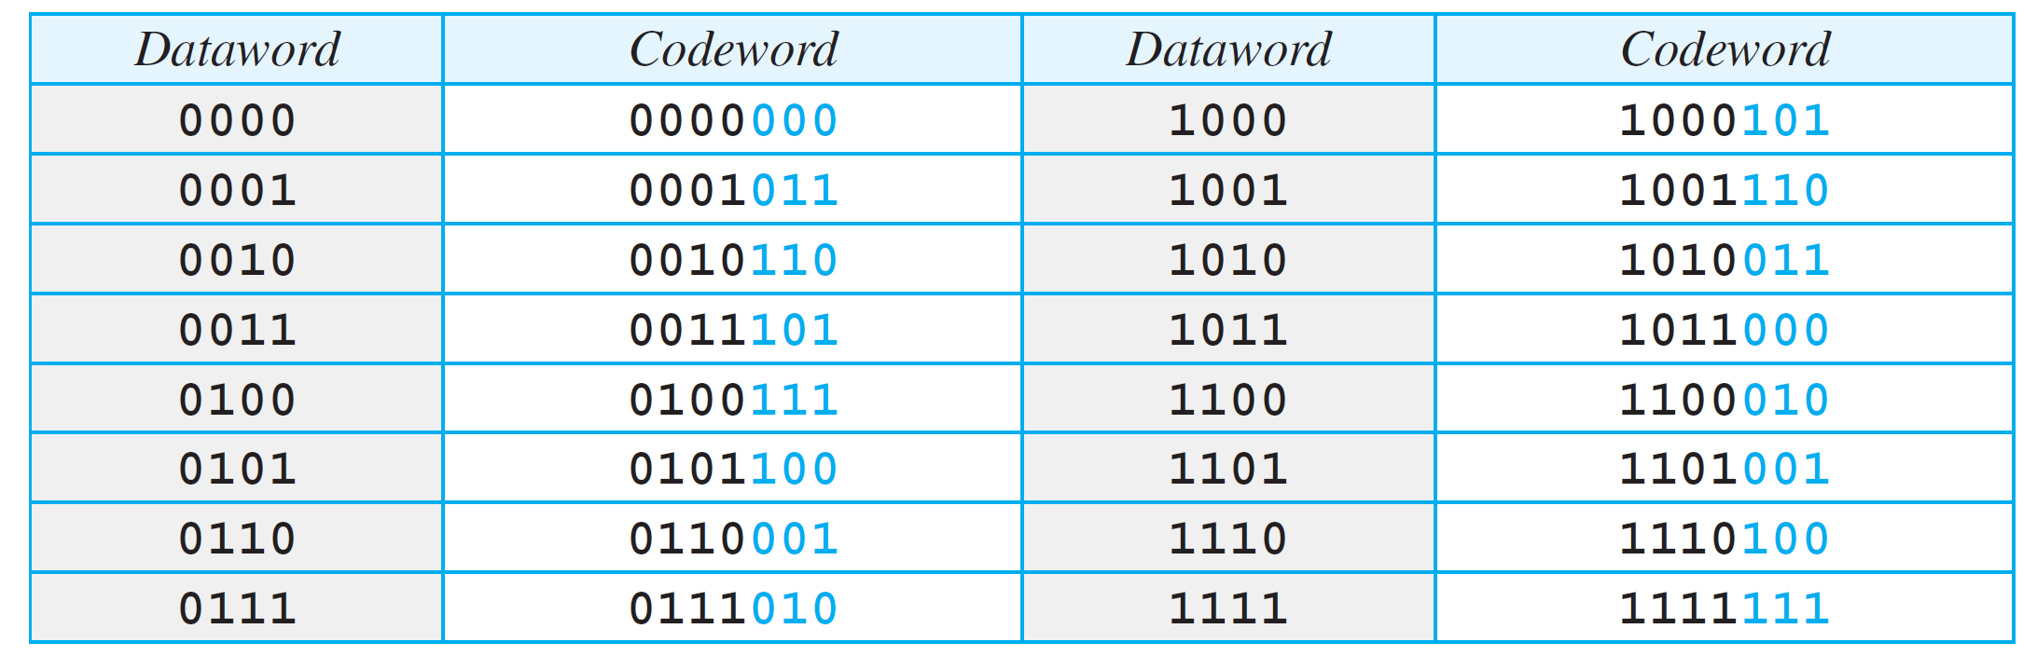
A CRC code with C(7, 4)

Slide 33
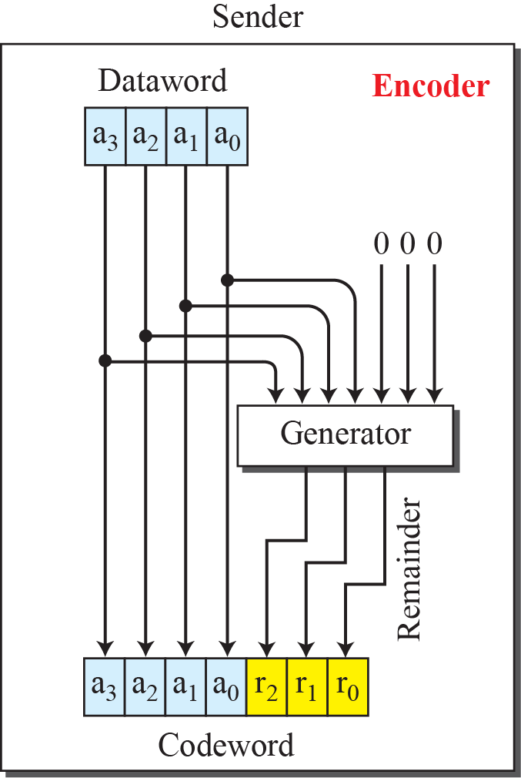
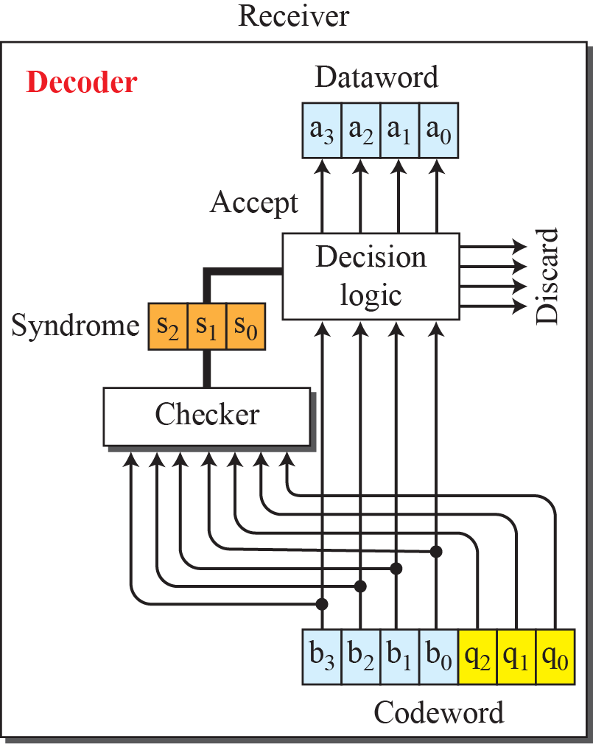
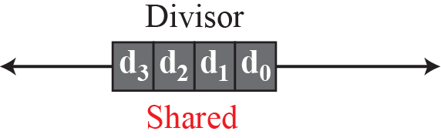
CRC encoder and decoder
Notes:
10.#

Slide 34
CRC
In the encoder, the data word has k bits(4 bits), code word has n bits(7 here).
The data word is augmented by adding n-k 0s to the right hand side of the word.
The n-bit result is fed to the generator.
The generator uses a divisor of size
n-k+1which is predefined and agreed upon.
The generator divides the augmented dataword

Slide 35
CRC
by divisor (modulo-2 division).
The quotient of the division is discarded.
The remainder r₂r₁ r₀ is appended to the data word to create the codeword.
The decoder receives the corrupted codeword.
A copy of all n bits are fed to the checker.
The remainder produced by checker is a syndrome of n-k bits, which is fed to the decision logic analyzer.
If syndrome bits are 0, the 4 left most bits of the code word are accepted as a data word.

Slide 36
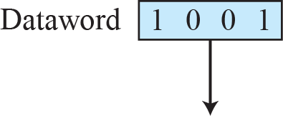
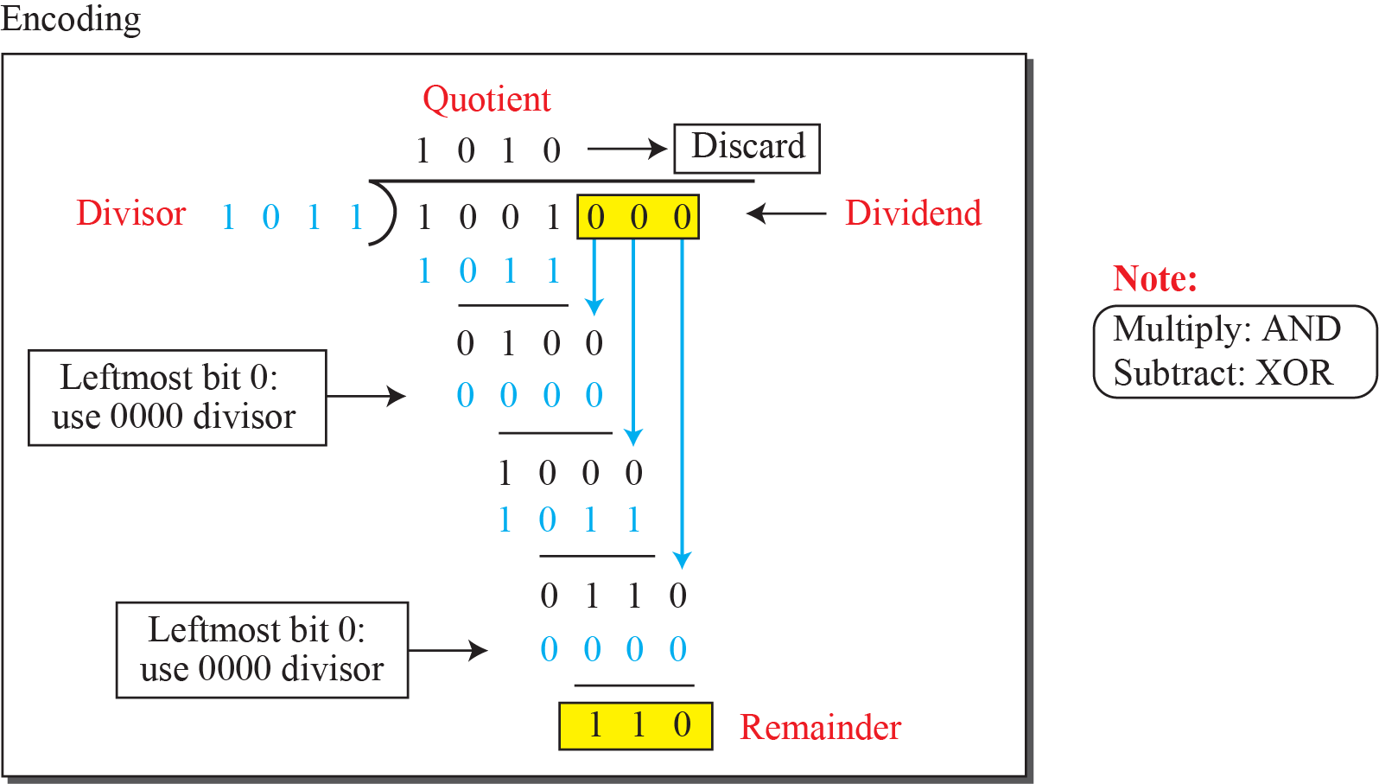
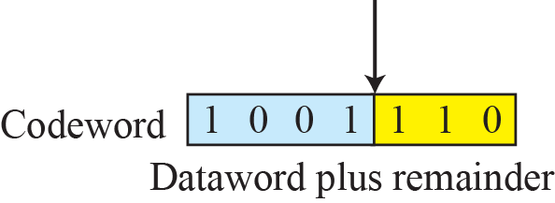
Division in CRC encoder
Notes:
10.#

Slide 37
CRC-Encoder
Encoder takes data word and augments it with n-k number of 0s.
It then divides the augmented data word by a divisor.
Modulo-2 binary division is used. For Addition and subtraction, XOR operations is used.
In each step, copy of the divisor is XOR ed with 4 bits of dividend. The result of XOR operation is 3 bits.

Slide 38
CRC-Decoder
Code word can change during transmission.
The decoder same thing as encoder and remainder of the division id the syndrome.
If syndrome is all 0s, no error, data word is separated from the code word and accepted.
Otherwise , everything is discarded.
Question is how divisor 1011 is chosen??

Slide 39
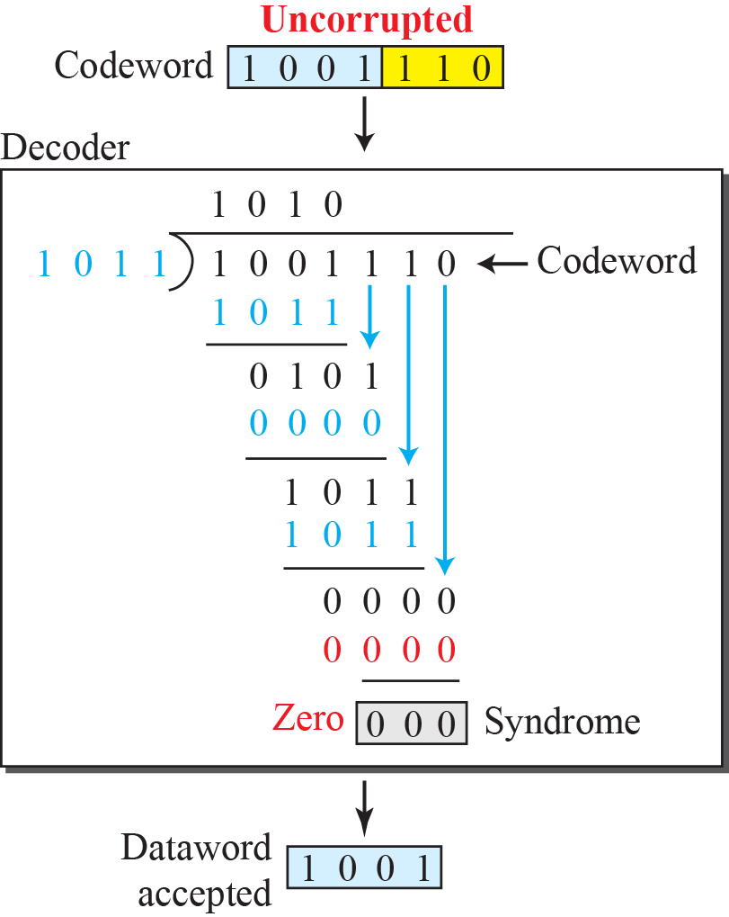
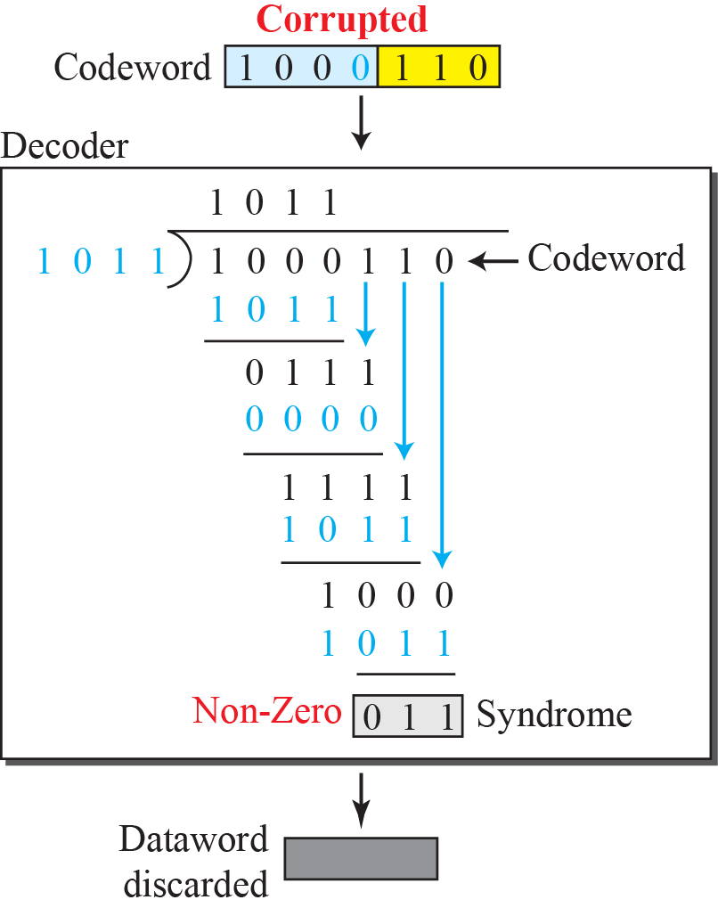
Division in the CRC decoder for two cases
Notes:
10.#

Slide 40
Polynomials
A better way to understand cyclic codes, and how they can be analyzed is to represent them as polynomials.
A pattern of 0s and 1s can be represented as polynomial with coefficient of 0 and 1.
The power of each term shows the position of the bit.
The coefficient shows the value of the bit.

Slide 41
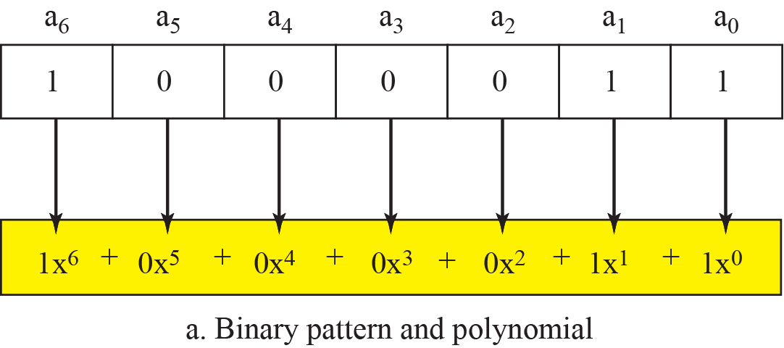
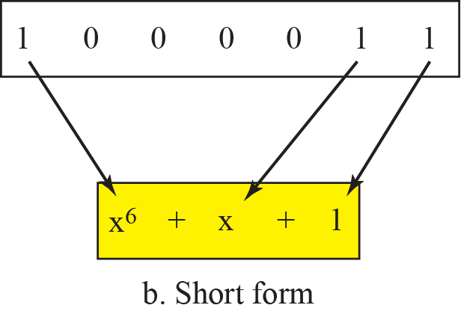
A polynomial to represent a binary word
Notes:
10.#

Slide 42
Degree of Polynomials
Is the highest power of the polynomial.
Eg: Degree of x⁶ + x+1 is 6.
Degree of polynomial is one less than that the number of bits in the pattern.
Addition and subtraction of polynomials is done by adding and subtracting the coefficient terms with the same power.
Coefficients are only 0 and 1, and adding is in modulo-2

Slide 43
Adding and subtracting of polynomials
Addition and subtraction is done by combining terms and deleting pair of identical terms.
Eg: x⁵ + x⁴+x²
x⁶ +x⁴+x²
-------------------------------
x⁶ + x⁵

Slide 44
Multiplication and Division of polynomials
Multiplication is adding powers.
Eg: x⁴ * x² = x⁶
Division, subtract the power of second term from the first term.
Eg: x⁵ / x² = x³
Multiplication of two polynomials
(x⁵ + x³ + x² ) (x² + x + 1)= x⁷ + x⁶ + x⁵ + x⁵ + x⁴ + x³ + x⁴+ x³
+ x²
→ x⁷ + x⁶ + x²

Slide 45
Shifting of polynomials
A binary pattern is shifted left or right by number of bits.
Shifting to the left means adding extra 0s as right most bits.
Shifting to the right means deleting some right most bits.
Shifting to the left is accomplished by multiplying each term of the polynomial by xm where m is the number of shifted bits

Slide 46
Continued..
Shifting to the right is accomplished by dividing each term of the polynomial by x^{m} where m is the number of shifted bits.
Shift left by 3 bits :10011 becomes 10011000
x⁴+x +1 becomes x⁷ + x⁴+x³
Shift right by 3 bits: 10011 becomes 10
x⁴+x +1 becomes x

Slide 47
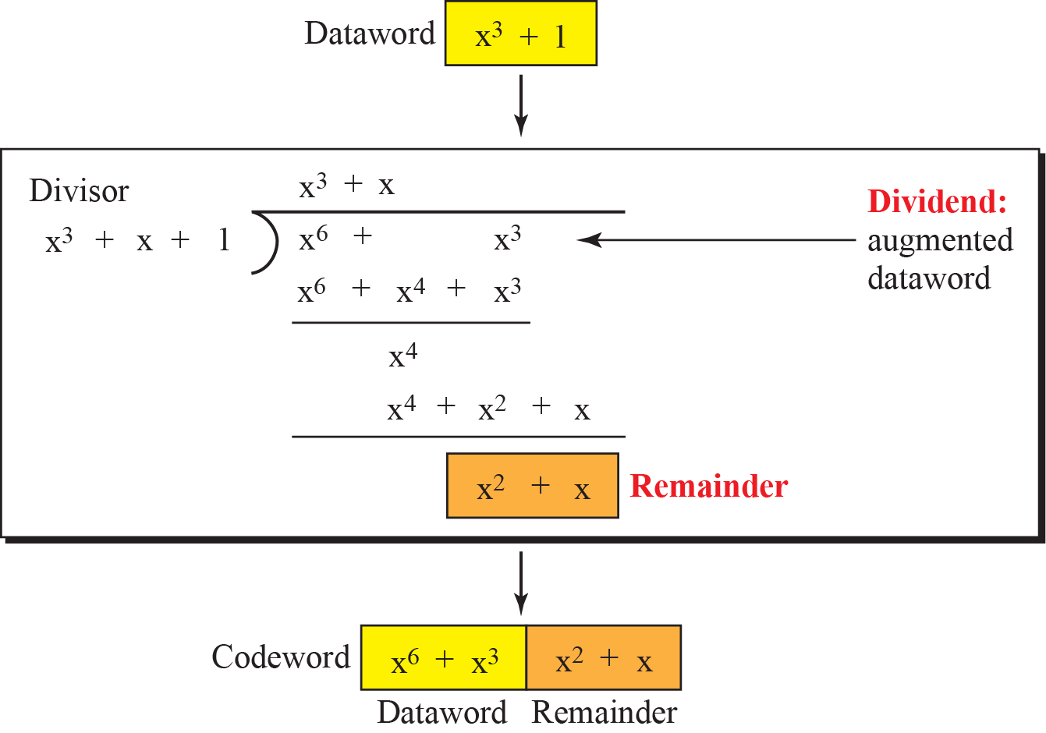
CRC division using polynomials
Notes:
10.#

Slide 48
Cyclic code analysis using polynomials
In a polynomial representation, divisor is normally referred to as generator polynomial t(x).
f(x) is the polynomial with binary coefficients
data word d(x), code word c(x), Generator g(x)
syndrome s(x) and error e(x).
→ Is s(x) is not zero, one or more bits are corrupted. If s(x) is zero, either no error or decoder failed to detect any error.

Slide 49


Cyclic Code Analysis
Analyze a cyclic code to find its capabilities by using polynomials.
Define the following, where f(x) is a polynomial with binary coefficients.
Notes:
10.#

Slide 50
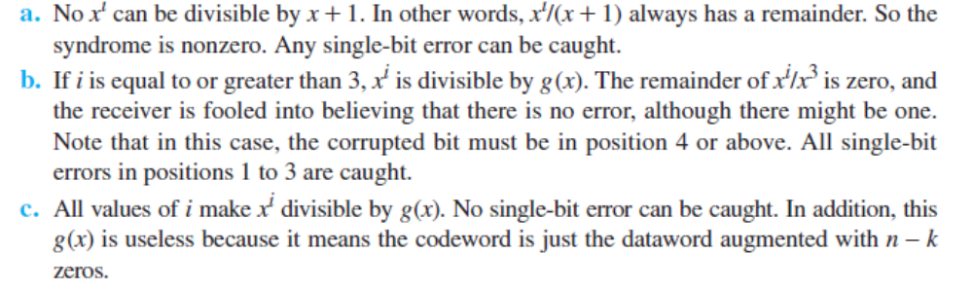
Example 10.8
Which of the following g(x) values guarantees that a single-bit error is caught? x + 1, x³ and 1
Solution

Slide 51
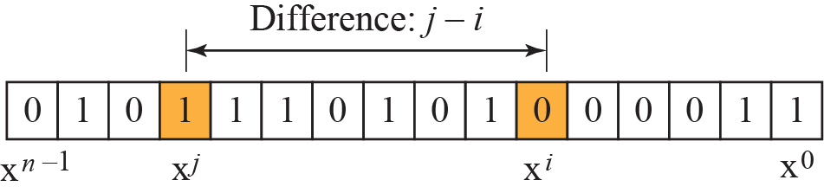
Representation of isolated single-bit errors
Notes:
10.#

Slide 52
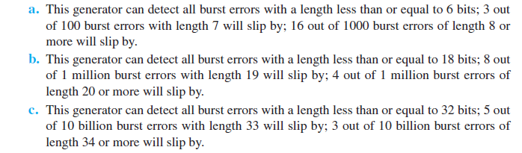
Example 10.9
Find the suitability of the following generators in relation to burst errors of different lengths: x⁶ + 1, x¹⁸ + x⁷ + x + 1, and x³² + x²³ + x⁷ + 10.
Solution

Slide 53
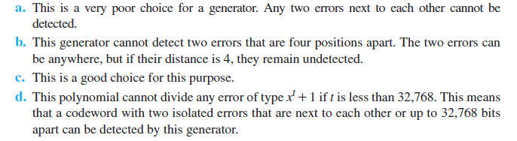
Example 10.10
Find the status of the following generators related to two isolated, single-bit errors: x + 1, x⁴ + 1, x⁷ + x⁶ + 1, and
x¹⁵ + x¹⁴ + 1
Solution

Slide 54
Summary
A good polynomial generator needs to have the following characteristics:
1. It should have at least two terms.
2. The coefficient of the term x⁰ should
be 1.
3. It should not divide x^{t} + 1, for t
between 2 and n − 1.
4. It should have the factor x + 1.

Slide 55
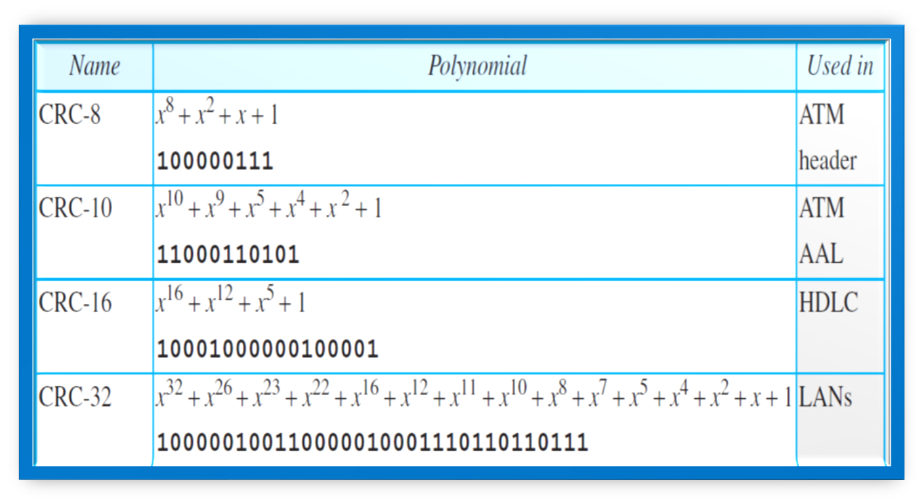
Table :Standard polynomials

Slide 56
Advantages of Cyclic Codes
Cyclic codes have a very good performance in detecting single-bit errors, double errors, an odd number of errors, and burst errors.
They can easily be implemented in hardware and software.
They are especially fast when implemented in hardware which has made cyclic codes a good candidate for many networks.
Notes:
10.#

Slide 57
Other Cyclic Codes
The cyclic codes we have discussed are very simple.
The check bits and syndromes can be calculated by simple algebra.
There are, however, more powerful polynomials that are based on abstract algebra involving Galois fields.
One of the most interesting of these codes is the Reed-Solomon code used today for both detection and correction.
Notes:
10.#

Slide 58
    10-4 CHECKSUM
Checksum is an error-detecting technique that can be applied to a message of any length.
In the Internet, the checksum technique is mostly used at the network and transport layer rather than the data-link layer.
At source,
Message is divided into m-bit units.
Generator then creates an extra m-bit unit called checksum, which is sent with message.
Notes:
10.#

Slide 59
    CHECKSUM
At Destination,
Checker creates a new checksum from combination of the message and the sent checksum.
If new checksum is all 0’s, the message is accepted else discarded.
Notes:
10.#

Slide 60
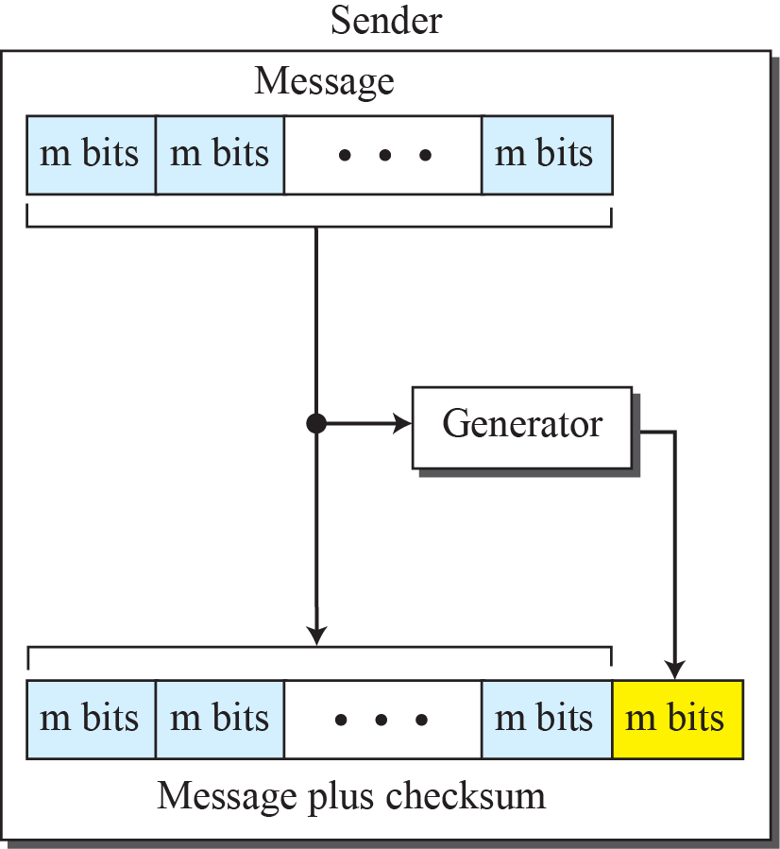
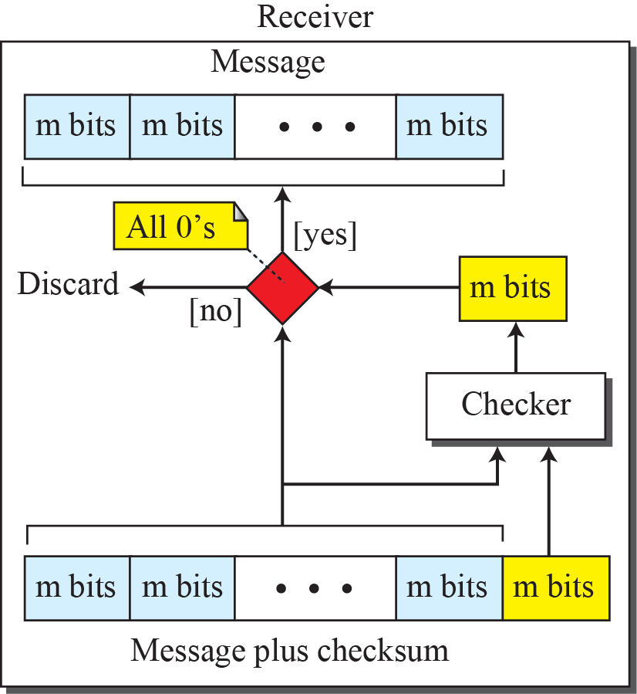
Checksum
Notes:
10.#

Slide 61
Concept
The idea of the traditional checksum is simple.
Show this using a simple example.
Suppose the message is a list of five 4-bit numbers that we want to send to a destination.
In addition to sending these numbers, we send the sum of the numbers.
Eg: if the set of numbers is (7, 11, 12, 0, 6), we send (7, 11, 12, 0, 6, 36), where 36 is the sum of the original numbers. The receiver adds the five numbers and compares the result with the sum.
If the two are the same, the receiver assumes no error, accepts the five numbers, and discards the sum.
Otherwise, there is an error somewhere and the message not accepted.
Notes:
10.#

Slide 62
Ones compliment Addition
Each number can be written as a 4 bit word except sum.
This drawback we can over come using ones compliment arithmetic.
Represent unsigned numbers between 0 and 2^{m} -1
Using only m bits.
If the number has more than m bits, the extra leftmost bits need to be added to the m rightmost bits.
Notes:
10.#

Slide 63
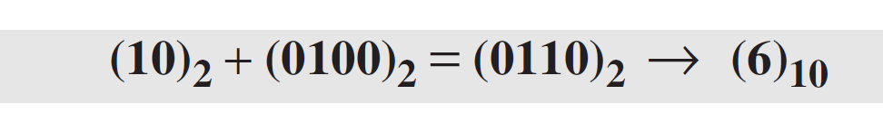
Example 10.12
In the previous example, the decimal number 36 in binary is (100100)2. To change it to a 4-bit number we add the extra leftmost bit to the right four bits as shown below.
Instead of sending 36 as the sum, we can send 6 as the sum (7, 11, 12, 0, 6, 6).
The receiver can add the first five numbers in one’s complement arithmetic.
If the result is 6, the numbers are accepted; otherwise, they are rejected.

Slide 64
Example 10.13
Let us use the idea of the checksum in Example 10.12. The sender adds all five numbers in one’s complement to get the sum = 6.
The sender then complements the result to get the checksum = 9, which is 15 − 6.
Note that 6 = (0110)2 and 9 = (1001)2;they are complements of each other.
The sender sends the five data numbers and the checksum (7, 11, 12, 0, 6, 9).
If there is no corruption in transmission, the receiver receives (7, 11, 12, 0, 6, 9) and adds them in one’s complement to get 15.

Slide 65
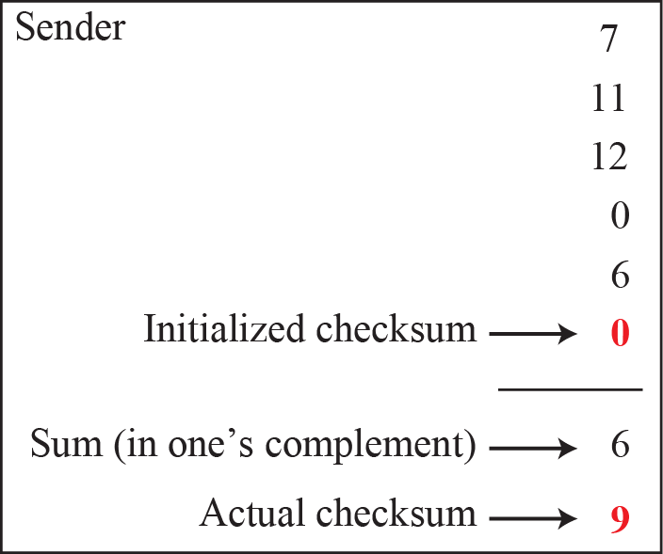
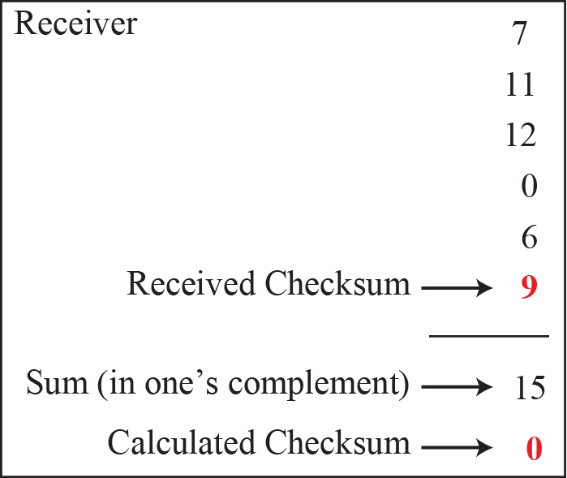
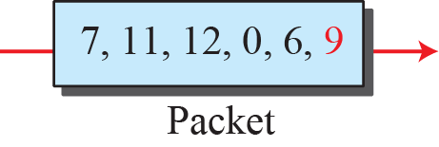
Example 10.13
Notes:
10.#

Slide 66
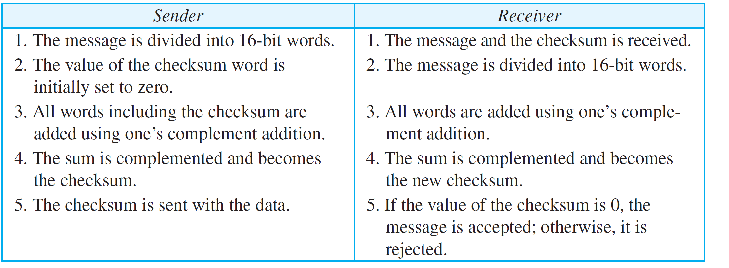
Table : Procedure to calculate the traditional checksum

Slide 67
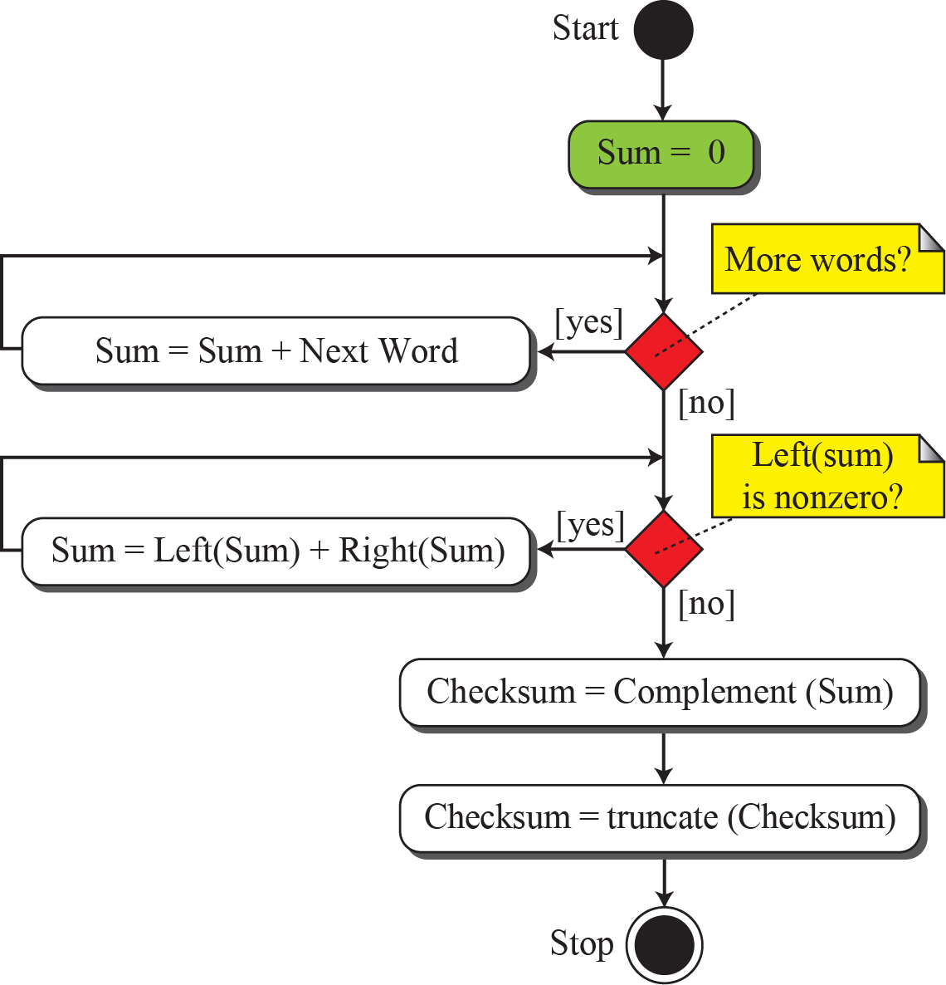
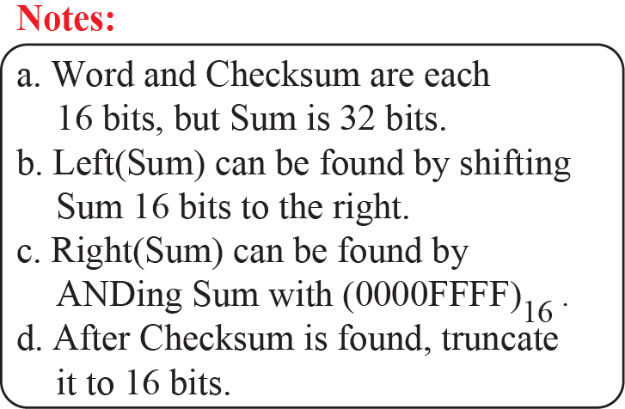
Algorithm to calculate a traditional checksum
Notes:
10.#

Slide 68
Other Approaches
One major problem with the traditional checksum calculation.
If two 16-bit items are transposed in transmission, the checksum cannot catch this error.
The reason is that the traditional checksum is not weighted: it treats each data item equally.
In other words, the order of data items is immaterial to the calculation.
Several approaches have been used to prevent this problem.
Two of them are: Fletcher and Adler.
Notes:
10.#

Slide 69
Fletcher Checksum
Was devised to weight each data item according to its position.
Two algorithms i) 8-bit ii) 16-bit.
In 8 bit Fletcher, calculation is done on 8-bit data and creates 16 bit checksum.
Calculation is done using modulo256(2⁸ )i.e intermediate results are divided by 256 and remainder is kept.
Algorithm uses two accumulators L & R
First simply adds data items together,
Second adds weights to the calculation.
In 16 bit Fletecher, calculation is done on 16-bit data and creates 32 bit checksum.

Slide 70
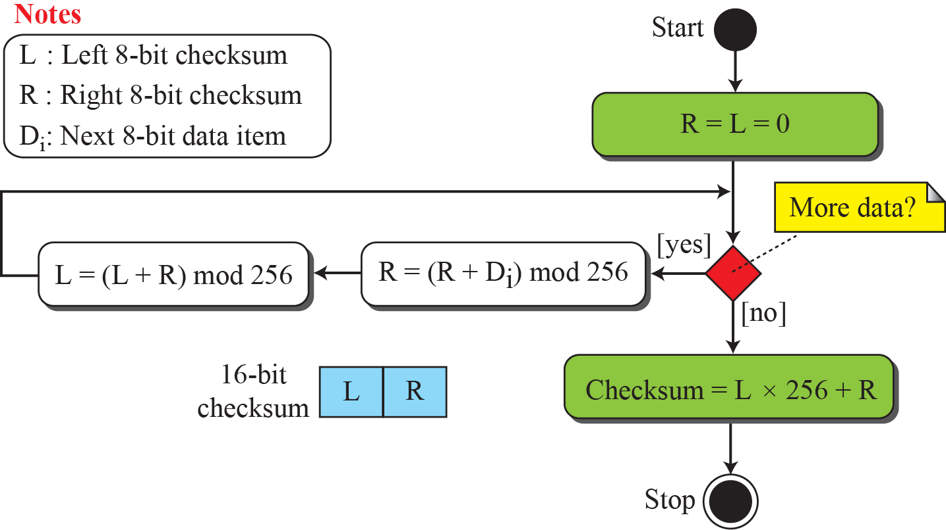
Algorithm to calculate an 8-bit Fletcher checksum
Notes:
10.#

Slide 71
Adler Checksum
Is a 32 bit checksum.
Similar to Fletcher.
3 Major differences
i) Calculation is done on single byte instead of 2 bytes at a time
ii) Modulus is a prime number(65,521)instead of 65,536.
iii) L is initialized to 1 instead of 0

Slide 72
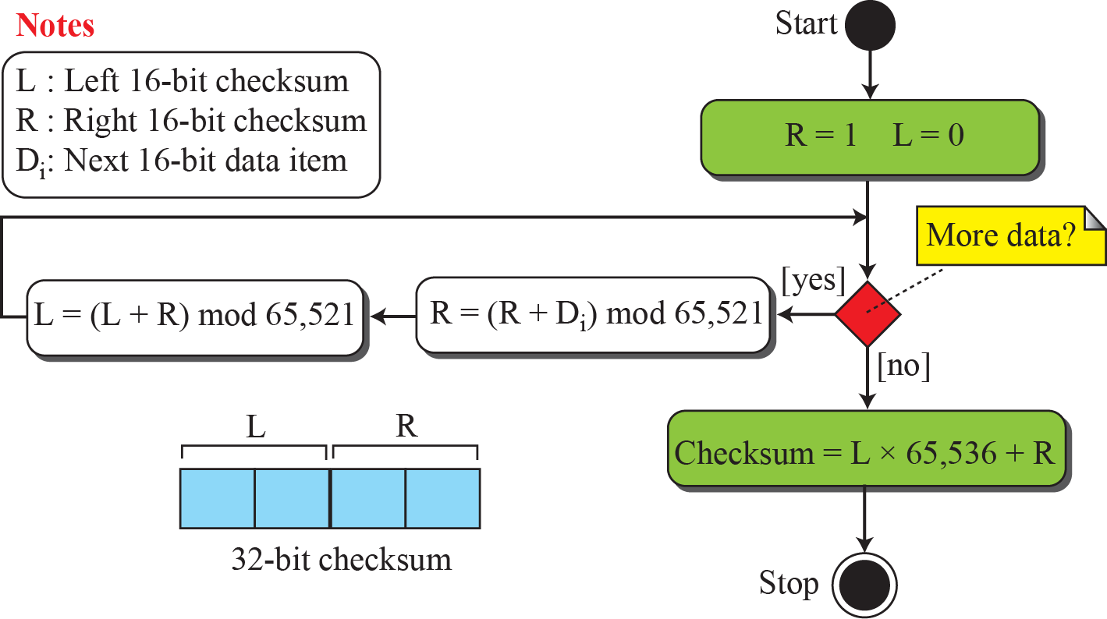
Algorithm to calculate an Adler checksum
Notes:
10.#

